Slide 1

REFLECTIONS
Introduction
As I progress through my course/program, it’s important to reflect on my goals, the impact of the skills I’m learning, and the steps I need to take to grow. This reflection focuses on my aspirations, how design thinking supports them, and the actions I can take to enhance my potential in the industry.
Presented by:

Slide 2
a. What is your goal/dream with regard to your course/program?
My goal is to learn the skills and knowledge needed to succeed in my field.
My dream is to become a skilled professional who can create meaningful solutions and make a positive impact.
b. How does this design thinking impact on your goal/dream with regard to your program?
Design thinking helps me solve problems in creative and practical ways.
It focuses on understanding users' needs, which is important for creating effective solutions and achieving my goals.

Slide 3

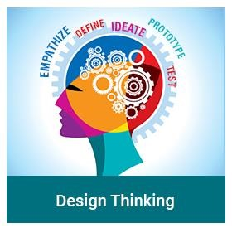

What is the action/improvement/plan necessary for you to improve
your potential in the industry?
To improve, I plan to:
1
2
3
Learn and practice new skills in my field.
Work on real projects to gain experience.
Build teamwork and communication skills.
4
5
Use design thinking to create better solutions.
Connect with professionals for guidance.

Slide 4
Conclusion
In conclusion, reflecting on my goals and the role of design thinking has helped me better understand how to align my learning with my aspirations. By taking focused actions to improve my skills, gain experience, and apply innovative approaches, I am confident in my ability to achieve my dreams and make a meaningful impact in my field.
Ahmed Abdelhafiz
A24CS4003
Thank you

